Slide 1
Picture Techniques II
COMP120: Creative Computing

Slide 2
Learning Objectives
By the end of this session you should be able to:
Implement controlled color changes using conditional logic
Separate background and foreground using subtraction

Slide 3
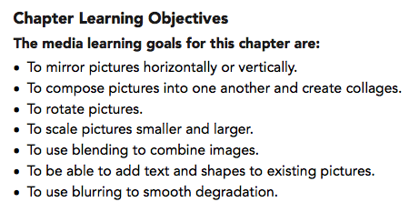
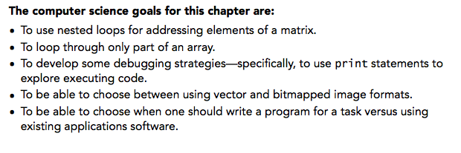
Chapter Learning Goals

Slide 4
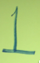
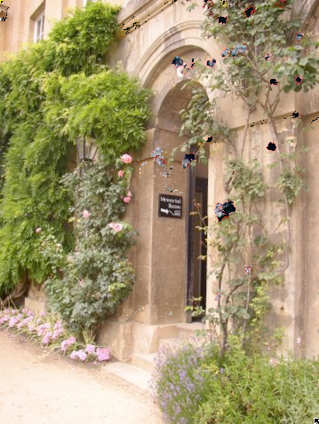
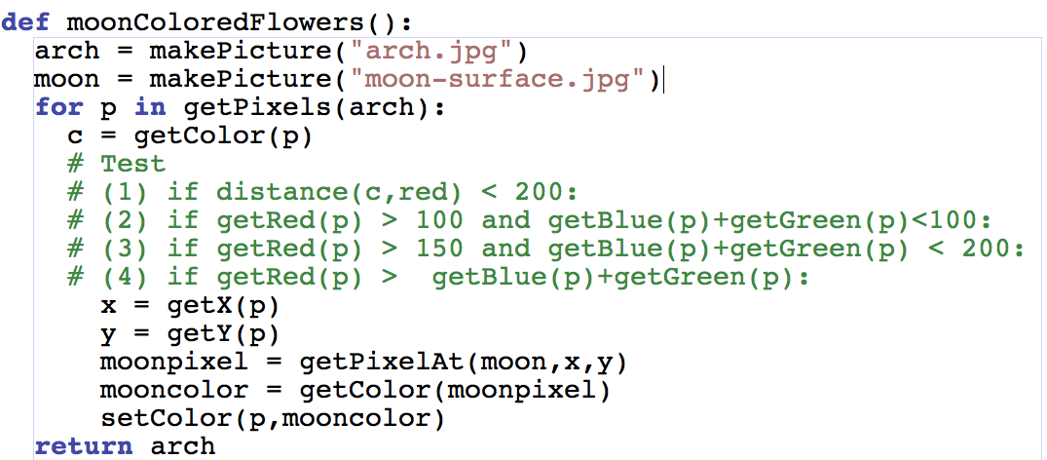

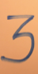
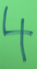
There are four conditional statements in this program for turning the red flowers in the arch into moon-colored flowers.
One of the generated this image. Which one?
Notes:
#3

Slide 5
Pixels are in a matrix
Matrices have two dimensions: A height and a width
We can reference any element in the matrix with (x,y) or (horizontal, vertical)
We refer to those coordinates as index numbers or indices
We sometimes want to know where a pixel is, and getPixels doesn't let us know that.

Slide 6
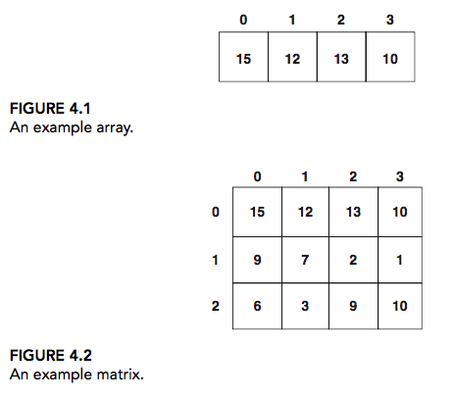
Arrays vs Matrices

Slide 7
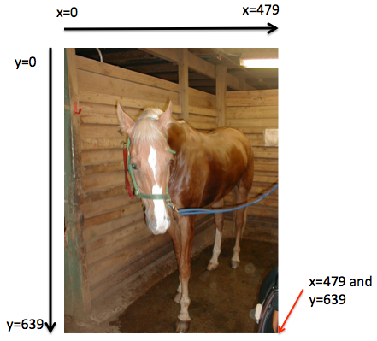
Pixels in a Matrix
>>> h = makePicture("horse.jpg")
>>> print getHeight(h)
640
>>> print getWidth(h)
480
>>> print getPixel(h,0,0)
Pixel red=62 green=78 blue=49
>>> print getPixel(h,479,639)
Pixel red=113 green=89 blue=77
>>> print getPixel(h,480,640)
getPixel(picture,x,y): x (= 480) is less than 0 or bigger than the width (= 479)
The error was:
Inappropriate argument value (of correct type).
An error occurred attempting to pass an argument to a function.

Slide 8
Indices from the function range
Range returns a sequence between its first two inputs, possibly using a third input as the increment
>>> print range(1,4)
[1, 2, 3]
>>> print range(-1,3)
[-1, 0, 1, 2]
>>> print range(1,10,2)
[1, 3, 5, 7, 9]
>>> print range(3)
[0,1,2]
Notice:
End value is never included.
range(0,10) ends at 9.
If you leave out a start value, it's assumed to be zero.

Slide 9
Side Note: That thing in [] is a sequence
>>> a=[1,2,3]
>>> print a
[1, 2, 3]
>>> a = a + 4
An attempt was made to call a function with a parameter of an invalid type
>>> a = a + [4]
>>> print a
[1, 2, 3, 4]
>>> a[0]
1
We can assign names to sequences, print them, add items to sequences, and access individual pieces of them.
We can also use for loops to process each element of a sequence.

Slide 10
We can use range to generate index numbers
We'll do this by working the range from 0 to the height-1, and 0 to the width-1.
Using the range function will make it easy to start from 0 and stop before the end value.
But we'll need more than one loop.
Each for loop can only change one variable, and we need two for indexing a matrix

Slide 11
Working the pixels by number
To use range, we'll have to use nested loops
One to walk the width, the other to walk the height
Be sure to watch your blocks (i.e., indentation) carefully!
def increaseRed2(picture):
for x in range(0,getWidth(picture)):
for y in range(0,getHeight(picture)):
px = getPixel(picture,x,y)
value = getRed(px)
setRed(px,value*1.1)

Slide 12
What's going on here?
def increaseRed2(picture):
for x in range(0,getWidth(picture)):
for y in range(0,getHeight(picture)):
px = getPixel(picture,x,y)
value = getRed(px)
setRed(px,value*1.1)
The first time through the first loop, x is the name for 0.
We'll be processing the first column of pixels in the picture.

Slide 13
Now, the inner loop
def increaseRed2(picture):
for x in range(0,getWidth(picture)):
for y in range(0,getHeight(picture)):
px = getPixel(picture,x,y)
value = getRed(px)
setRed(px,value*1.1)
Next, we set y to 0. We're now going to process each of the pixels in the first column.

Slide 14
Process a pixel
def increaseRed2(picture):
for x in range(0,getWidth(picture)):
for y in range(0,getHeight(picture)):
px = getPixel(picture,x,y)
value = getRed(px)
setRed(px,value*1.1)
With x = 0 and y = 0, we get the leftmost pixel and increase its red by 10%

Slide 15
Next pixel
def increaseRed2(picture):
for x in range(0,getWidth(picture)):
for y in range(0,getHeight(picture)):
px = getPixel(picture,x,y)
value = getRed(px)
setRed(px,value*1.1)
Next we set y to 1 (next value in the sequence range(0,getHeight(picture))

Slide 16
Process pixel (0,1)
x is still 0, and now y is 1, so increase the red for pixel (0,1)
def increaseRed2(picture):
for x in range(0,getWidth(picture)):
for y in range(0,getHeight(picture)):
px = getPixel(picture,x,y)
value = getRed(px)
setRed(px,value*1.1)
We continue along this way, with y taking on every value from 0 to the height of the picture (minus 1).

Slide 17
Finally, next column
def increaseRed2(picture):
for x in range(0,getWidth(picture)):
for y in range(0,getHeight(picture)):
px = getPixel(picture,x,y)
value = getRed(px)
setRed(px,value*1.1)
Now that we're done with the loop for y, we get back to the FOR loop for x. x takes on the value 1, and we go back to the y loop to process all the pixels in the column x=1.

Slide 18
Lightening a Picture with Nested Loops
def lighten2(picture):
for x in range(0,getWidth(picture)):
for y in range(0,getHeight(picture)):
px = getPixel(picture,x,y)
color = getColor(px)
color = makeLighter(color)
setColor(px,color)

Slide 19
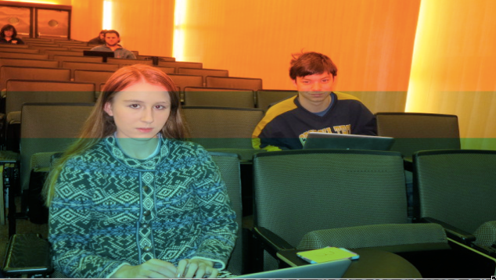
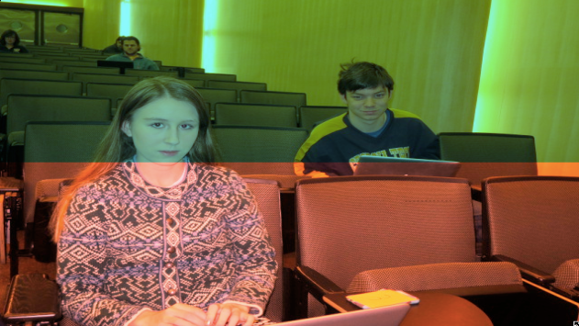
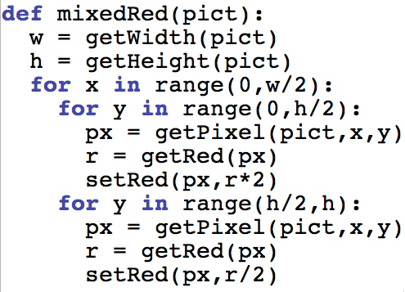
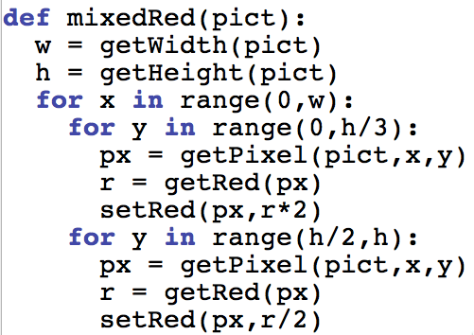
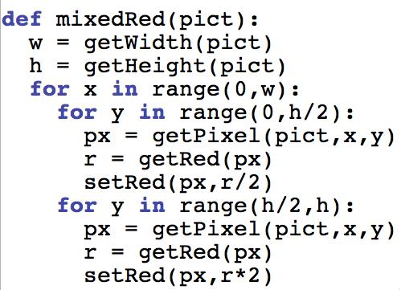
A
B
Which function did A?
Notes:
#1 is A. #3 is B

Slide 20
Reducing Red Eye with Nested Loops
def removeRedEye2(pic,sX,sY,eX,eY,endColor):
for x in range(sX,eX):
for y in range(sY,eY):
px = getPixel(pic,x,y)
if (distance(red,getColor(px)) < 165):
setColor(px,endColor)
This version is far faster than the previous version

Slide 21
Timing
from time import clock
def yellowbox1(pict):
start = clock()
for px in getPixels(pict):
x = getX(px)
y = getY(px)
if 10 <= x < 20 and 10 <= y < 20:
setColor(px,yellow)
print "Time:",clock()-start
def yellowbox2(pict):
start = clock()
for x in range(10,20):
for y in range(10,20):
setColor(getPixel(pict,x,y),yellow)
print "Time:",clock()-start
>>> b = makePicture("bridge.jpg")
>>> b
Picture, filename /Users/guzdial/Desktop/mediasources-4ed/bridge.jpg height 640 width 480
>>> yellowbox1(b)
Time: 1.317775
>>> yellowbox2(b)
Time: 0.00316000000001

Slide 22
What can you do if you know where the pixels are? One answer: Mirroring
Imagine a mirror horizontally across the picture, or vertically
What would we see?
How do generate that digitally?
We simply copy the colors of pixels from one place to another

Slide 23
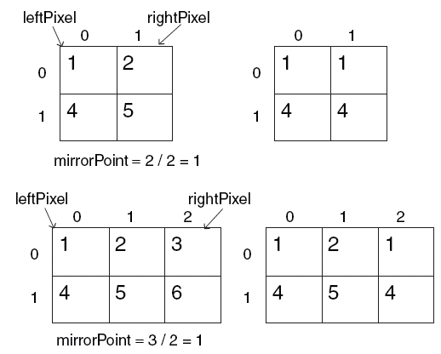
Work it out with matrices
mirrorPoint is halfway across: getWidth(picture)/2
If left pixel is at (x,y), right pixel is at (width-x-1,y)

Slide 24
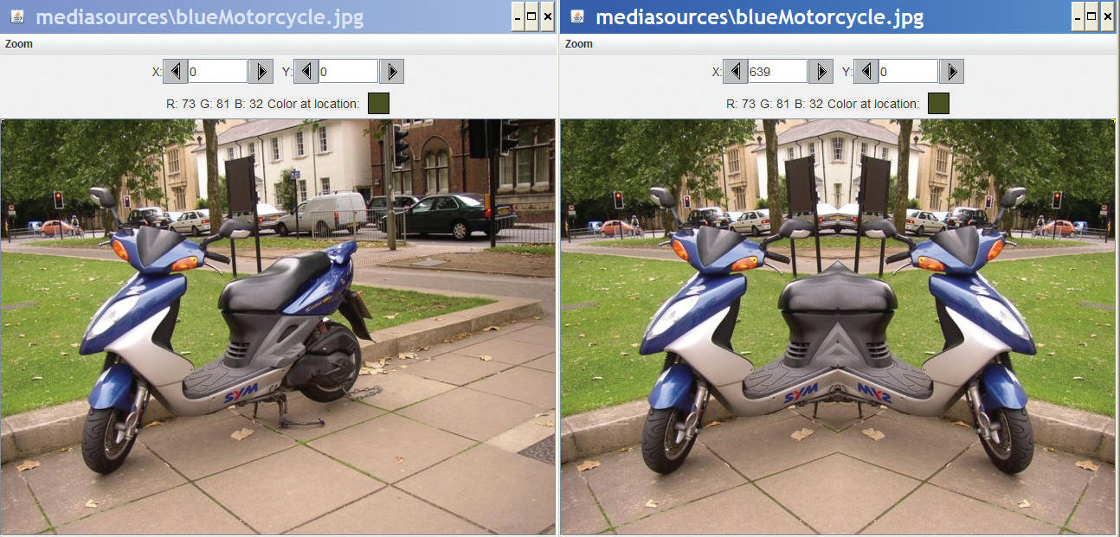
Recipe for mirroring
def mirrorVertical(source):
mirrorPoint = getWidth(source) / 2
width = getWidth(source)
for y in range(0,getHeight(source)):
for x in range(0,mirrorPoint):
leftPixel = getPixel(source,x,y)
rightPixel = getPixel(source,width - x - 1,y)
color = getColor(leftPixel)
setColor(rightPixel,color)

Slide 25
Can we do it with a horizontal mirror?
def mirrorHorizontal(source):
mirrorPoint = getHeight(source) / 2
height = getHeight(source)
for x in range(0,getWidth(source)):
for y in range(0,mirrorPoint):
topPixel = getPixel(source,x,y)
bottomPixel = getPixel(source,x,height - y - 1)
color = getColor(topPixel)
setColor(bottomPixel,color)

Slide 26
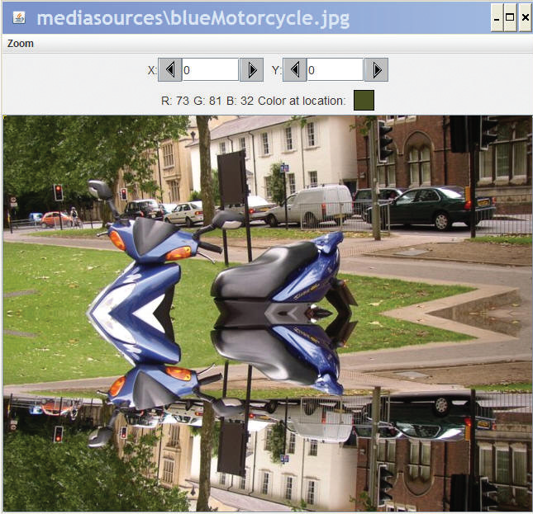
Of course!

Slide 27
What if we wanted to copy bottom to top?
Very simple: Swap the order of pixels in the bottom lines
def mirrorBotTop(source):
mirrorPoint = getHeight(source) / 2
height = getHeight(source)
for x in range(0,getWidth(source)):
for y in range(0,mirrorPoint):
topPixel = getPixel(source,x,y)
bottomPixel = getPixel(source,x,height - y - 1)
color = getColor(bottomPixel)
setColor(topPixel,color)

Slide 28
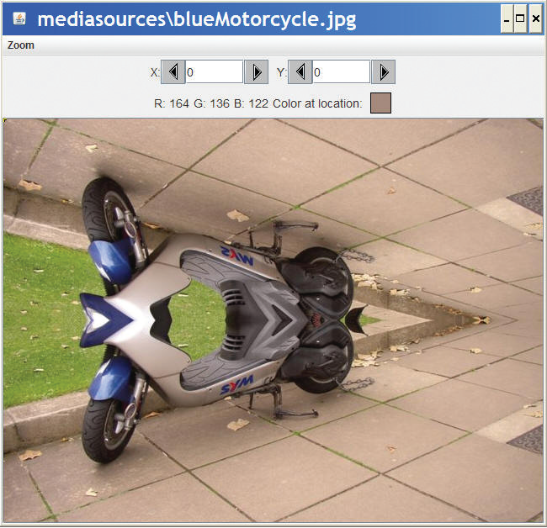
Mirroring bottom to top

Slide 29
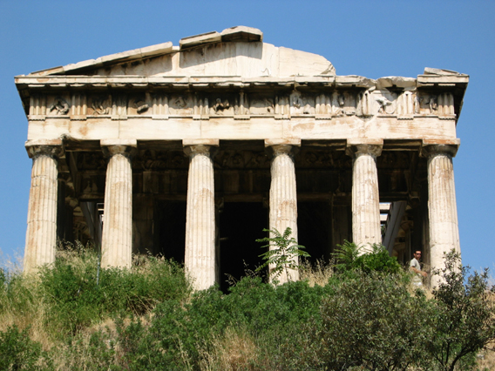
Doing something useful with mirroring
Mirroring can be used to create interesting effects, but it can also be used to create realistic effects.
Consider this image from a trip to Athens, Greece.
Can we “repair” the temple by mirroring the complete part onto the broken part?

Slide 30
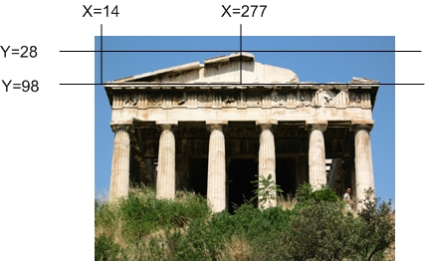
Figuring out where to mirror
Use MediaTools to find the mirror point and the range that we want to copy

Slide 31
Writing functions for specific files…generally
The function to mirror the temple needs to work for one and only one file.
But we still don't want to write out the whole path.
setMediaPath() allows us to pick a directory where our media will be stored.
getMediaPath(filename) will generate the entire path for us to the filename in the media directory
THIS ONLY WORKS WHEN WE'RE ACCESSING FILES IN THE MEDIA DIRECTORY AND WHERE WE HAVE SET THE PATH FIRST!

Slide 32
Some Utility Functions
If you know the name of the file, searching for it with pickAFile() feels tedious
You can set and get a media folder (path) for remembering a place where your media will be coming from (or going to)
setMediaPath() lets you pick a file in your media folder
getMediaPath(basefilename) lets you generate a complete filename out of only the last part

Slide 33
Example
>>> setMediaPath()
New media folder: C:\Documents and Settings\Mark Guzdial\My Documents\mediasources\
>>> getMediaPath("barbara.jpg")
'C:\\Documents and Settings\\Mark Guzdial\\My Documents\\mediasources\\barbara.jpg'
>>> barb=makePicture(getMediaPath("barbara.jpg"))

Slide 34
Program to mirror the temple
def mirrorTemple():
source = makePicture(getMediaPath("temple.jpg"))
mirrorPoint = 276
for x in range(13,mirrorPoint):
for y in range(27,97):
pleft = getPixel(source,x,y)
pright = getPixel(source,mirrorPoint + mirrorPoint - 1 - x,y)
setColor(pright,getColor(pleft))
show(source)
return source

Slide 35
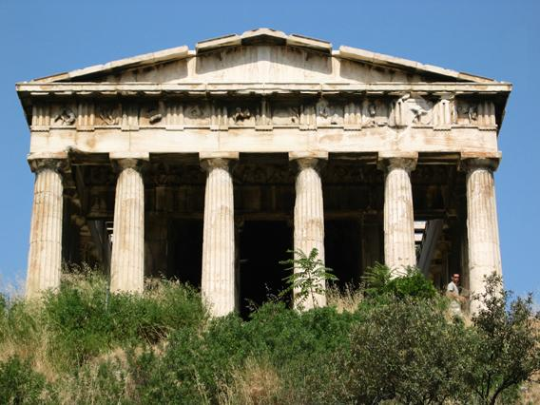
Did it really work?
It clearly did the mirroring, but that doesn't create a 100% realistic image.
Check out the shadows: Which direction is the sun coming from?

Slide 36
Understanding the Temple Fix
What is the very first transfer of pixels from and to? Which (x,y) pixel from? Which (x,y) pixel to?
What is second?
How many pixels get copied?

Slide 37
Adding print statements to see what's happening
def mirrorTemple():
source = makePicture(getMediaPath("temple.jpg"))
mirrorPoint = 276
for x in range(13,mirrorPoint):
for y in range(27,97):
print "Copying color from",x,y, " to ",mirrorPoint + mirrorPoint - 1 - x, y
pleft = getPixel(source,x,y)
pright = getPixel(source,mirrorPoint + mirrorPoint - 1 - x,y)
setColor(pright,getColor(pleft))
show(source)
return source

Slide 38
First pixels are either side of the mirrorpoint, then moving down
>>> p2=mirrorTemple()
Copying color from 13 27 to 538 27
Copying color from 13 28 to 538 28
Copying color from 13 29 to 538 29

Slide 39
Counting pixels
def mirrorTemple():
source = makePicture(getMediaPath("temple.jpg"))
mirrorPoint = 276
count = 0
for x in range(13,mirrorPoint):
for y in range(27,97):
pleft = getPixel(source,x,y)
pright = getPixel(source,mirrorPoint + mirrorPoint - 1 - x,y)
setColor(pright,getColor(pleft))
count = count + 1
show(source)
print "We copied",count,"pixels"
return source

Slide 40
Counting pixels
>>> p2=mirrorTemple()
We copied 18410 pixels
Where did that come from?
How many rows? Y goes from 27 to 97
= 70 rows of pixels
How many columns? X goes from 13 to 276
= 263 columns of pixels
70 * 263 = 18410

Slide 41
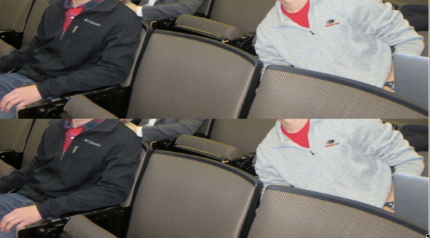
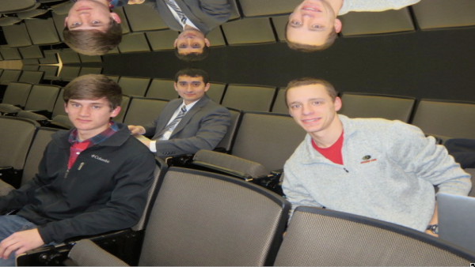
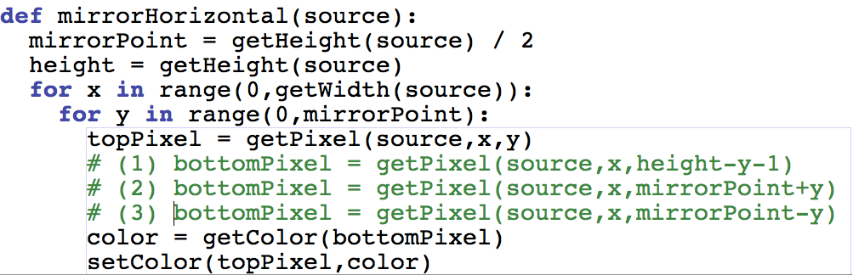
A
B
The same function below did the two pictures, but with one line difference. Which one did which picture?
Notes:
#2 is A. #3 is B

Slide 42
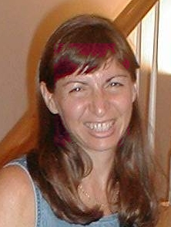
Replacing colors in a range
def turnRedInRange():
brown = makeColor(57,16,8)
file=“/Users/guzdial/mediasources/barbara.jpg"
picture=makePicture(file)
for x in range(70,168):
for y in range(56,190):
px=getPixel(picture,x,y)
color = getColor(px)
if distance(color,brown)<50.0:
redness=getRed(px)*1.5
setRed(px,redness)
show(picture)
return(picture)
Get the range using MediaTools

Slide 43
Walking this code
Like last time: Don't need input, same color we want to change, same file, make a picture
def turnRedInRange():
brown = makeColor(57,16,8)
file=“/Users/guzdial/mediasources/barbara.jpg"
picture=makePicture(file)
for x in range(70,168):
for y in range(56,190):
px=getPixel(picture,x,y)
color = getColor(px)
if distance(color,brown)<50.0:
redness=getRed(px)*1.5
setRed(px,redness)
show(picture)
return(picture)

Slide 44
The nested loop
I used MediaTools to find the rectangle where most of the hair is that I want to change
def turnRedInRange():
brown = makeColor(57,16,8)
file=“/Users/guzdial/mediasources/barbara.jpg“
picture=makePicture(file)
for x in range(70,168):
for y in range(56,190):
px=getPixel(picture,x,y)
color = getColor(px)
if distance(color,brown)<50.0:
redness=getRed(px)*1.5
setRed(px,redness)
show(picture)
return(picture)

Slide 45
Same thing as last time (could raise threshold now)
Then we're looking for a close-match on hair color, and increasing the redness
def turnRedInRange():
brown = makeColor(57,16,8)
file=“/Users/guzdial/mediasources/barbara.jpg“
picture=makePicture(file)
for x in range(70,168):
for y in range(56,190):
px=getPixel(picture,x,y)
color = getColor(px)
if distance(color,brown)<50.0:
redness=getRed(px)*1.5
setRed(px,redness)
show(picture)
return(picture)

Slide 46
Could we do this without nested loops?
Yes, but complicated IF
def turnRedInRange2():
brown = makeColor(57,16,8)
file=“/Users/guzdial/mediasources/barbara.jpg“
picture=makePicture(file)
for p in getPixels(picture):
x = getX(p)
y = getY(p)
if x >= 70 and x < 168:
if y >=56 and y < 190:
color = getColor(p)
if distance(color,brown)<100.0:
redness=getRed(p)*2.0
setRed(p,redness)
show(picture)
return picture

Slide 47
Moving pixels across pictures
We've seen using index variables to track the pixel position we're working with in a picture.
We can copy between pictures, if we keep track of:
The source index variables
Where we're getting the pixels from
The target index variables
Where we're putting the pixels at
(Not really copying the pixels: Replicating their color.)

Slide 48
What can you do then?
What can you do when copying from one picture to another?
Collages: Copy several pictures onto one
Cropping: You don't have to take the whole picture
Scaling: Make a picture smaller, or larger when copying it

Slide 49
Copying pixels
In general, what we want to do is to keep track of a sourceX and sourceY, and a targetX and targetY.
We increment (add to them) in pairs
sourceX and targetX get incremented together
sourceY and targetY get incremented together
The tricky parts are:
Setting values inside the body of loops
Incrementing at the bottom of loops

Slide 50
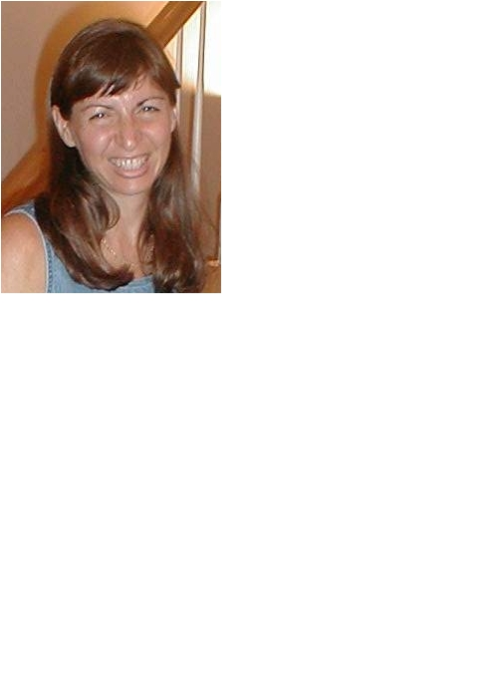
Copying Barb to a canvas
def copyBarb():
# Set up the source and target pictures
barbf=getMediaPath("barbara.jpg")
barb = makePicture(barbf)
canvasf = getMediaPath("7inX95in.jpg")
canvas = makePicture(canvasf)
# Now, do the actual copying
targetX = 0
for sourceX in range(0,getWidth(barb)):
targetY = 0
for sourceY in range(0,getHeight(barb)):
color = getColor(getPixel(barb,sourceX,sourceY))
setColor(getPixel(canvas,targetX,targetY), color)
targetY = targetY + 1
targetX = targetX + 1
show(barb)
show(canvas)
return canvas

Slide 51
Comments
Python ignores from “#” through the rest of the line
If you start a line with “#”, the whole line is ignored
Why do we want lines to be ignored?
To be able to leave notes to ourselves or someone else about how the program works

Slide 52
Walking through the copying function
First, get the source (barb) and target (canvas) files and pictures as names we can use later.
def copyBarb():
# Set up the source and target pictures
barbf=getMediaPath("barbara.jpg")
barb = makePicture(barbf)
canvasf = getMediaPath("7inX95in.jpg")
canvas = makePicture(canvasf)
# Now, do the actual copying
targetX = 0
for sourceX in range(0,getWidth(barb)):
targetY = 0
for sourceY in range(0,getHeight(barb)):
color = getColor(getPixel(barb,sourceX,sourceY))
setColor(getPixel(canvas,targetX,targetY), color)
targetY = targetY + 1
targetX = targetX + 1
show(barb)
show(canvas)
return canvas

Slide 53
The actual copy
def copyBarb():
# Set up the source and target pictures
barbf=getMediaPath("barbara.jpg")
barb = makePicture(barbf)
canvasf = getMediaPath("7inX95in.jpg")
canvas = makePicture(canvasf)
# Now, do the actual copying
targetX = 0
for sourceX in range(0,getWidth(barb)):
targetY = 0
for sourceY in range(0,getHeight(barb)):
color = getColor(getPixel(barb,sourceX,sourceY))
setColor(getPixel(canvas,targetX,targetY), color)
targetY = targetY + 1
targetX = targetX + 1
show(barb)
show(canvas)
return canvas
We get the color of the pixel at sourceX and sourceY
We set (copy) the color to the pixel in the target picture at targetX and targetY

Slide 54
Setting up the copy loop
def copyBarb():
# Set up the source and target pictures
barbf=getMediaPath("barbara.jpg")
barb = makePicture(barbf)
canvasf = getMediaPath("7inX95in.jpg")
canvas = makePicture(canvasf)
# Now, do the actual copying
targetX = 0
for sourceX in range(0,getWidth(barb)):
targetY = 0
for sourceY in range(0,getHeight(barb)):
color = getColor(getPixel(barb,sourceX,sourceY))
setColor(getPixel(canvas,targetX,targetY), color)
targetY = targetY + 1
targetX = targetX + 1
show(barb)
show(canvas)
return canvas
targetX gets set to 0 at the beginning
sourceX will range across the width of the source picture
INSIDE the loop, we set targetY to 0
Inside because we want it to start at 0 each time we do a new X
sourceY will range from 0 to one less height of source

Slide 55
Ending the loop
def copyBarb():
# Set up the source and target pictures
barbf=getMediaPath("barbara.jpg")
barb = makePicture(barbf)
canvasf = getMediaPath("7inX95in.jpg")
canvas = makePicture(canvasf)
# Now, do the actual copying
targetX = 0
for sourceX in range(0,getWidth(barb)):
targetY = 0
for sourceY in range(0,getHeight(barb)):
color = getColor(getPixel(barb,sourceX,sourceY))
setColor(getPixel(canvas,targetX,targetY), color)
targetY = targetY + 1
targetX = targetX + 1
show(barb)
show(canvas)
return canvas
Just before we end the sourceY loop, we increment targetY
It's now set up for the next time through the loop
It's set correctly for the next value of sourceY
Just before we end the sourceX loop, we increment the targetX
Note carefully the indentation to figure out which goes with which loop

Slide 56
What's this naming something as itself?
targetX = targetX + 1
This isn't really naming something as itself
targetX + 1 is evaluated
It will result in the number after targetX
targetX = then sets the value of targetX
The result is that targetX gets incremented by 1

Slide 57
Ending the copy function
def copyBarb():
# Set up the source and target pictures
barbf=getMediaPath("barbara.jpg")
barb = makePicture(barbf)
canvasf = getMediaPath("7inX95in.jpg")
canvas = makePicture(canvasf)
# Now, do the actual copying
targetX = 0
for sourceX in range(0,getWidth(barb)):
targetY = 0
for sourceY in range(0,getHeight(barb)):
color = getColor(getPixel(barb,sourceX,sourceY))
setColor(getPixel(canvas,targetX,targetY), color)
targetY = targetY + 1
targetX = targetX + 1
show(barb)
show(canvas)
return canvas
At the very end, we show the source and target
And return the modified target.

Slide 58
Works either way
def copyBarb2():
# Set up the source and target pictures
barbf=getMediaPath("barbara.jpg")
barb = makePicture(barbf)
canvasf = getMediaPath("7inX95in.jpg")
canvas = makePicture(canvasf)
# Now, do the actual copying
sourceX = 0
for targetX in range(0,getWidth(barb)):
sourceY = 0
for targetY in range(0,getHeight(barb)):
color = getColor(getPixel(barb,sourceX,sourceY))
setColor(getPixel(canvas,targetX,targetY), color)
sourceY = sourceY + 1
sourceX = sourceX + 1
show(barb)
show(canvas)
return canvas
As long as we increment sourceX and targetX together, and sourceY and targetY together, it doesn't matter which is in the for loop and which is incremented via expression

Slide 59
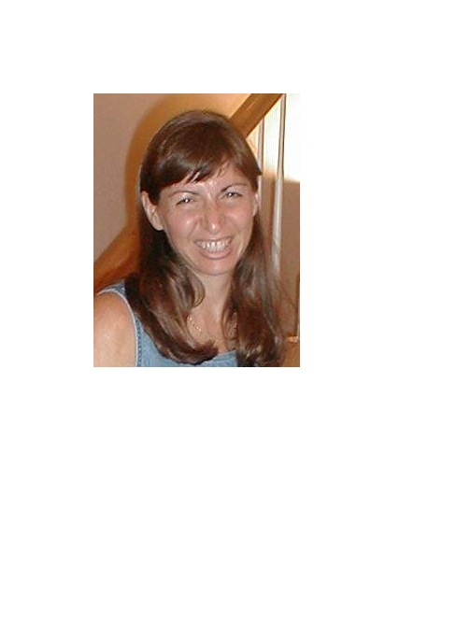
Copying into the middle of the canvas
def copyBarbMidway():
# Set up the source and target pictures
barbf=getMediaPath("barbara.jpg")
barb = makePicture(barbf)
canvasf = getMediaPath("7inX95in.jpg")
canvas = makePicture(canvasf)
# Now, do the actual copying
targetX = 100
for sourceX in range(0,getWidth(barb)):
targetY = 100
for sourceY in range(0,getHeight(barb)):
color = getColor(getPixel(barb,sourceX,sourceY))
setColor(getPixel(canvas,targetX,targetY), color)
targetY = targetY + 1
targetX = targetX + 1
show(barb)
show(canvas)
return canvas

Slide 60
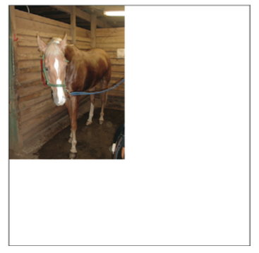
Copying a Horse to a Canvas
def copyHorse():
# Set up the source and target pictures
src = makePicture("horse.jpg")
canvas = makeEmptyPicture(1000,1000)
# Now, do the actual copying
targetX = 0
for sourceX in range(0,getWidth(src)):
targetY = 0
for sourceY in range(0,getHeight(src)):
color = getColor(getPixel(src,sourceX,sourceY))
setColor(getPixel(canvas,targetX,targetY), color)
targetY = targetY + 1
targetX = targetX + 1
show(src)
show(canvas)
return canvas

Slide 61
Copying another way
def copyHorse2():
# Set up the source and target pictures
src = makePicture("horse.jpg")
canvas = makeEmptyPicture(1000,1000)
# Now, do the actual copying
sourceX = 0
for targetX in range(0,getWidth(src)):
sourceY = 0
for targetY in range(0,getHeight(src)):
color = getColor(getPixel(src,sourceX,sourceY))
setColor(getPixel(canvas,targetX,targetY), color)
sourceY = sourceY + 1
sourceX = sourceX + 1
show(src)
show(canvas)
return canvas

Slide 62
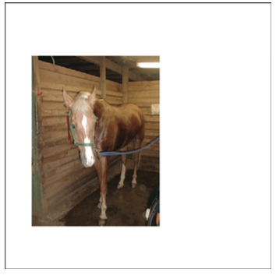
Copying to a new Location
def copyHorseMidway():
# Set up the source and target pictures
src = makePicture("horse.jpg")
canvas = makeEmptyPicture(1000,1000)
# Now, do the actual copying
targetX = 100
for sourceX in range(0,getWidth(src)):
targetY = 200
for sourceY in range(0,getHeight(src)):
color = getColor(getPixel(src,sourceX,sourceY))
setColor(getPixel(canvas,targetX,targetY), color)
targetY = targetY + 1
targetX = targetX + 1
show(src)
show(canvas)
return canvas

Slide 63
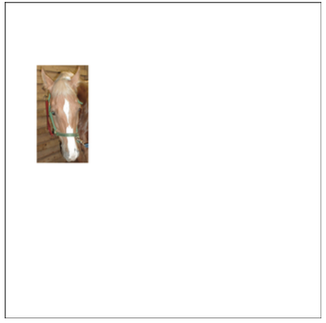
Cropping just the Face
def copyHorseFace():
# Set up the source and target pictures
src = makePicture("horse.jpg")
canvas = makeEmptyPicture(1000,1000)
# Now, do the actual copying
targetX = 100
for sourceX in range(104,267):
targetY = 200
for sourceY in range(114,422):
color = getColor(getPixel(src,sourceX,sourceY))
setColor(getPixel(canvas,targetX,targetY), color)
targetY = targetY + 1
targetX = targetX + 1
#show(src)
show(canvas)
return canvas

Slide 64
Same cropping, different loops
def copyHorseFace2():
# Set up the source and target pictures
src=makePicture("horse.jpg")
canvas = makeEmptyPicture(1000,1000)
# Now, do the actual copying
sourceX = 104
for targetX in range(100,100+163):
sourceY = 114
for targetY in range(200,200+308):
color = getColor(getPixel(src,sourceX,sourceY))
setColor(getPixel(canvas,targetX,targetY), color)
sourceY = sourceY + 1
sourceX = sourceX + 1
show(canvas)
return canvas

Slide 65
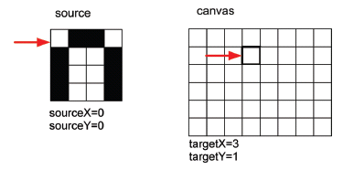
Copying: How it works
Here's the initial setup:

Slide 66
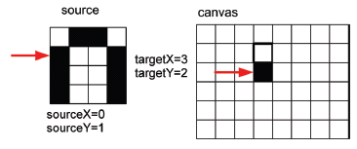
Copying: How it works 2
After incrementing the sourceY and targetY once (whether in the for or via expression):

Slide 67
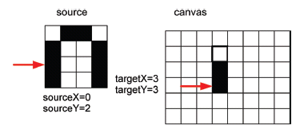
Copying: How it works 3
After yet another increment of sourceY and targetY:
When we finish that column, we increment sourceX and targetX, and start on the next column.

Slide 68
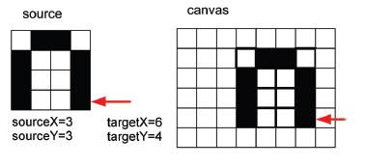
Copying: How it looks at the end
Eventually, we copy every pixel

Slide 69
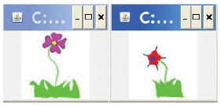
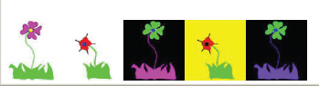
Making a collage
Could we do something to the pictures we copy in?
Sure! Could either apply one of those functions before copying, or do something to the pixels during the copy.
Could we copy more than one picture!
Of course! Make a collage!

Slide 70
#Third picture, flower1 negated
negative(flower1)
targetX=200
for sourceX in range(0,getWidth(flower1)):
targetY=getHeight(canvas)-getHeight(flower1)-5
for sourceY in range(0,getHeight(flower1)):
px=getPixel(flower1,sourceX,sourceY)
cx=getPixel(canvas,targetX,targetY)
setColor(cx,getColor(px))
targetY=targetY + 1
targetX=targetX + 1
#Fourth picture, flower2 with no blue
clearBlue(flower2)
targetX=300
for sourceX in range(0,getWidth(flower2)):
targetY=getHeight(canvas)-getHeight(flower2)-5
for sourceY in range(0,getHeight(flower2)):
px=getPixel(flower2,sourceX,sourceY)
cx=getPixel(canvas,targetX,targetY)
setColor(cx,getColor(px))
targetY=targetY + 1
targetX=targetX + 1
#Fifth picture, flower1, negated with decreased red
decreaseRed(flower1)
targetX=400
for sourceX in range(0,getWidth(flower1)):
targetY=getHeight(canvas)-getHeight(flower1)-5
for sourceY in range(0,getHeight(flower1)):
px=getPixel(flower1,sourceX,sourceY)
cx=getPixel(canvas,targetX,targetY)
setColor(cx,getColor(px))
targetY=targetY + 1
targetX=targetX + 1
show(canvas)
return(canvas)
def createCollage():
flower1=makePicture(getMediaPath("flower1.jpg"))
print flower1
flower2=makePicture(getMediaPath("flower2.jpg"))
print flower2
canvas=makePicture(getMediaPath("640x480.jpg"))
print canvas
#First picture, at left edge
targetX=0
for sourceX in range(0,getWidth(flower1)):
targetY=getHeight(canvas)-getHeight(flower1)-5
for sourceY in range(0,getHeight(flower1)):
px=getPixel(flower1,sourceX,sourceY)
cx=getPixel(canvas,targetX,targetY)
setColor(cx,getColor(px))
targetY=targetY + 1
targetX=targetX + 1
#Second picture, 100 pixels over
targetX=100
for sourceX in range(0,getWidth(flower2)):
targetY=getHeight(canvas)-getHeight(flower2)-5
for sourceY in range(0,getHeight(flower2)):
px=getPixel(flower2,sourceX,sourceY)
cx=getPixel(canvas,targetX,targetY)
setColor(cx,getColor(px))
targetY=targetY + 1
targetX=targetX + 1
Page 170-171 (4ed edition)

Slide 71
Can we make that easier?
The collage code is long, yet simple.
It's the same thing over-and-over.
We can generalize that copying loop, and with parameters, use it in many places.
def copy(source, target, targX, targY):
targetX = targX
for sourceX in range(0,getWidth(source)):
targetY = targY
for sourceY in range(0,getHeight(source)):
px=getPixel(source,sourceX,sourceY)
tx=getPixel(target,targetX,targetY)
setColor(tx,getColor(px))
targetY=targetY + 1
targetX=targetX + 1

Slide 72
Exact same collage!
def createCollage2():
flower1=makePicture(getMediaPath("flower1.jpg"))
print flower1
flower2=makePicture(getMediaPath("flower2.jpg"))
print flower2
canvas=makePicture(getMediaPath("640x480.jpg"))
print canvas
#First picture, at left edge
copy(flower1,canvas,0,getHeight(canvas)-getHeight(flower1)-5)
#Second picture, 100 pixels over
copy(flower2,canvas,100,getHeight(canvas)-getHeight(flower2)-5)
#Third picture, flower1 negated
negative(flower1)
copy(flower1,canvas,200,getHeight(canvas)-getHeight(flower1)-5)
#Fourth picture, flower2 with no blue
clearBlue(flower2)
copy(flower2,canvas,300,getHeight(canvas)-getHeight(flower2)-5)
#Fifth picture, flower1, negated with decreased red
decreaseRed(flower1)
copy(flower1,canvas,400,getHeight(canvas)-getHeight(flower2)-5)
return canvas

Slide 73
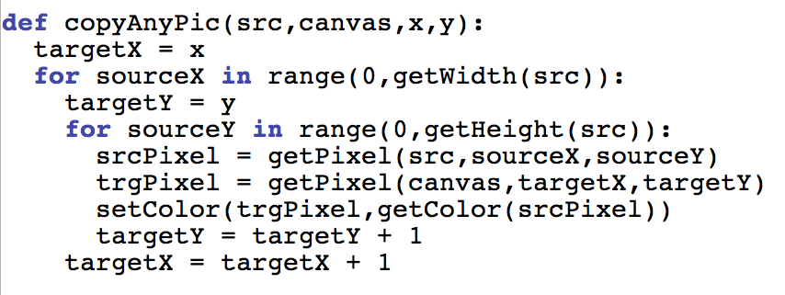
Make sure you have this Typed IN to Work From: Copy Any Pic

